Slide 1


SIL Uganda 2023
Breeder Meeting
Brian Diers

Slide 2
SIL Uganda Meeting
Welcome!
Thank you to Phinehas and his team for organizing the meeting.
This is an opportunity to meet, share ideas in presentations and talk informally to discuss your research programs
We hope that this interaction will foster research collaboration and germplasm exchanges

Slide 3
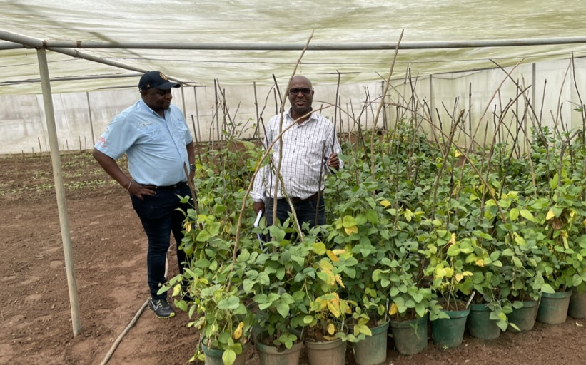
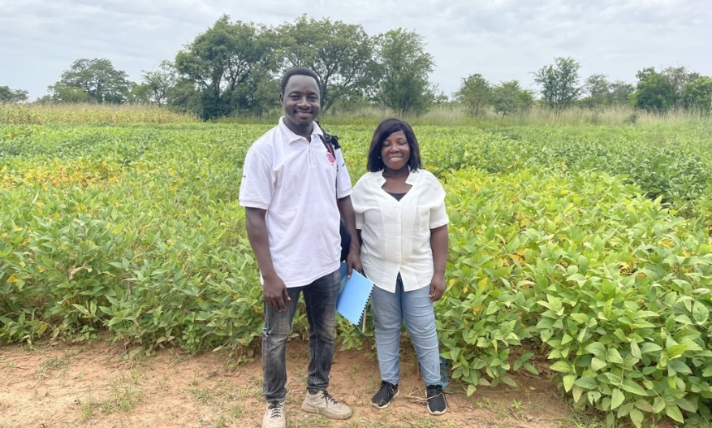
SIL Funding
SIL received five year renewal from USAID in October 2022
This is the third allotment of funding for SIL from USAID
There was a delay in receiving the last renewal from USAID which caused the funding lapse
Peter Goldsmith’s focus for the renewal is to make SIL funded programs independent so they can continue when SIL funding is gone
  Can breeders help fund programs through licensing fees?

Slide 4
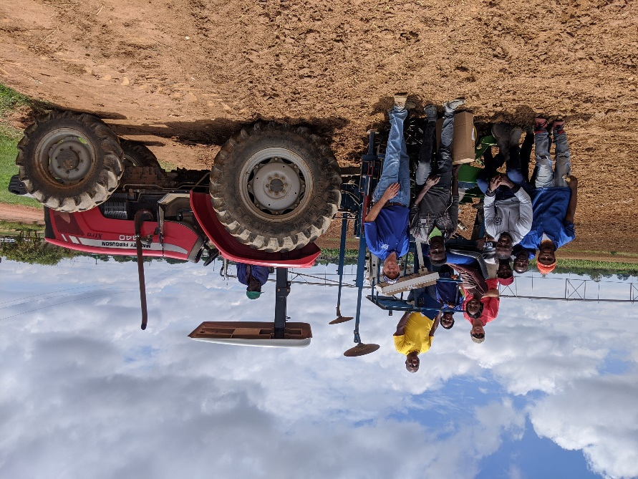
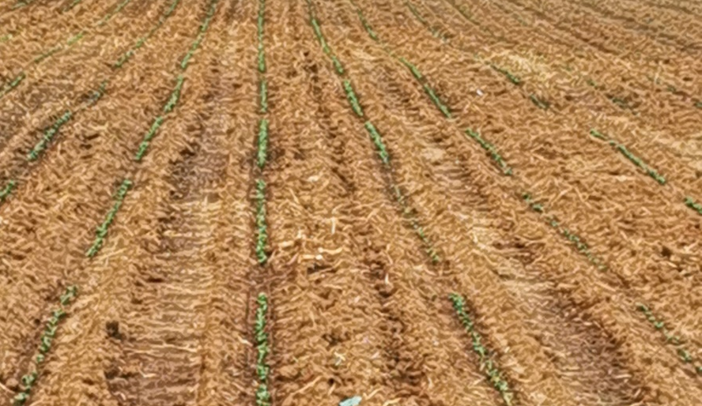
SIL Funding
I retired from my faculty position at the University of Illinois
  SIL hired me back part time to manage breeding work.
Andrew Scaboo will be leaving SIL because of other responsibilities
Carrie Miranda will stay with SIL
Will add Aaron Lorenz from the University of Minnesota. He is a leader in applying genomic selection to soybean

Slide 5
Funding New Projects
SIL sent a RFP for competitive funding of breeding programs
Received 13 proposals and funded five
Projects funded included:
  IITA in Nigeria
  IITA in Zambia
  EIAR in Ethiopia
  Makerere University in Uganda
  SARI in Ghana

Slide 6
Metrics
Number of plots
# of Experiment Lines

Slide 7
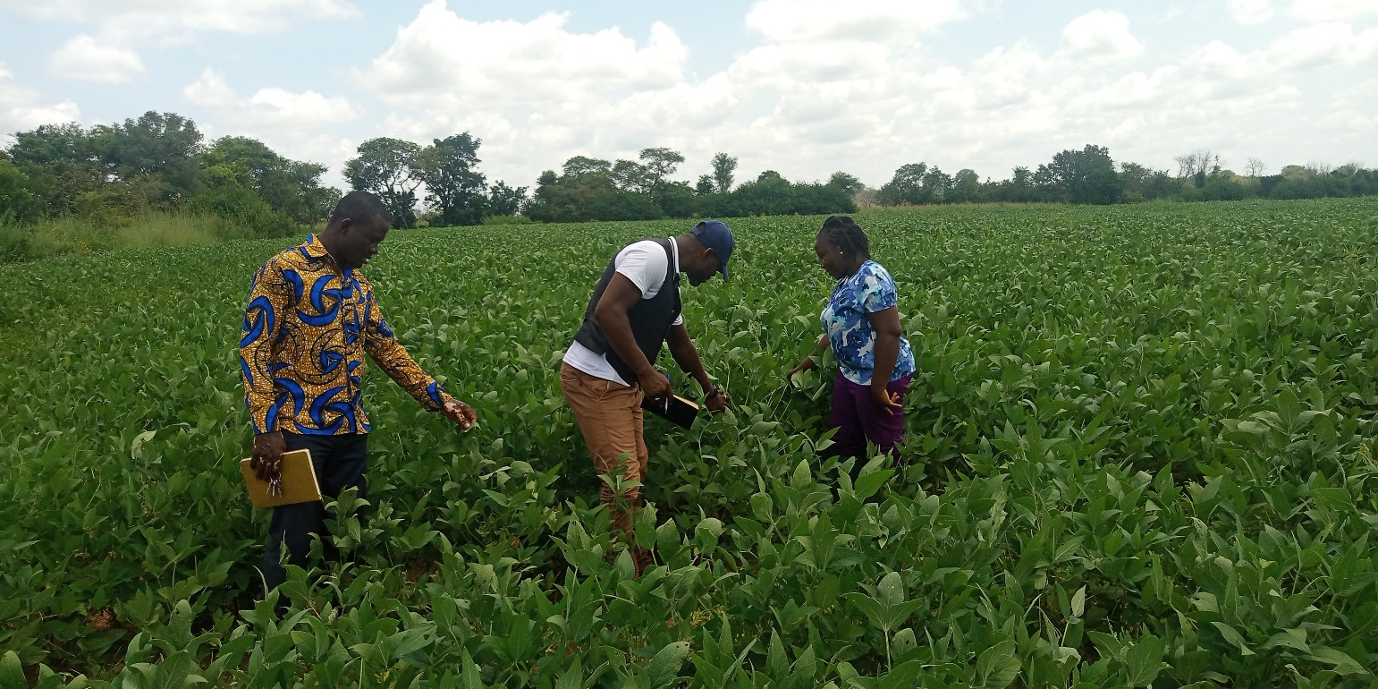
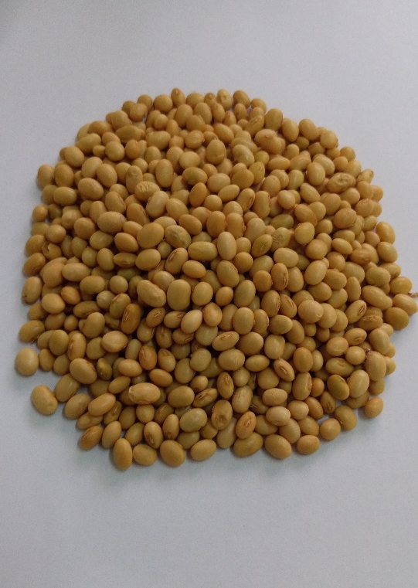
Variety Releases
Twenty varieties released between 2019 to 2022 compared to seven between 2013 to 2018.

Slide 8
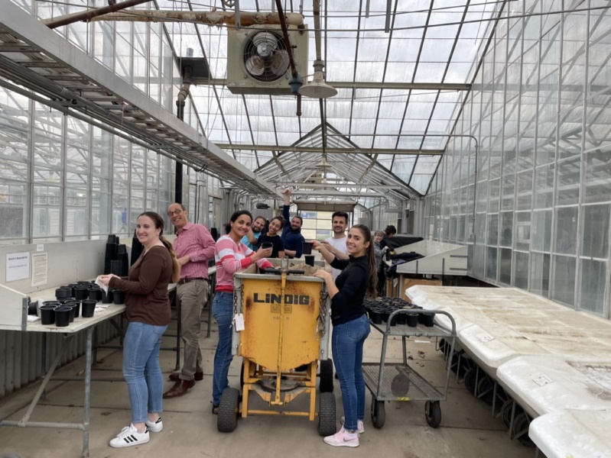
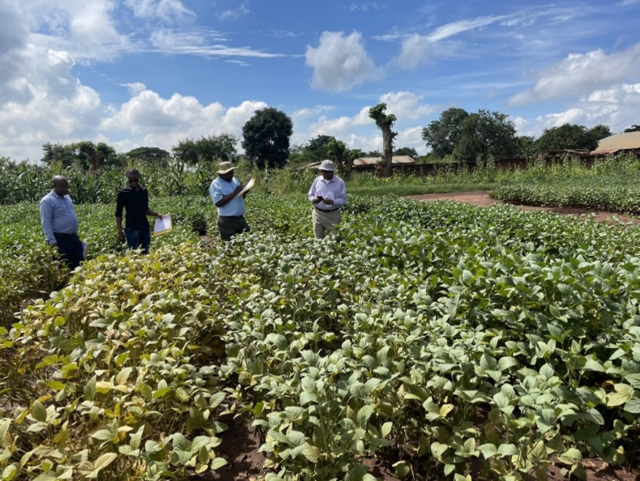
New Projects
Working with Bayer and IITA on the Modern Breeding Project
  Analyzed data from genotyping of almost 800 experimental lines from IITA with over 1,000 genetic markers
  Developing training data that can be used for genomic prediction
Arranged for seed from 33 lines and varieties developed in the midsouth and southern USA to be shipped to IITA
Sent maturity group checks to IITA for testing across Africa

