Slide 1
Research Proposal
Research Title: Socioeconomic Impacts of Oil Production on Women
The Case of Paloch Area in Melut County, Upper Nile State, Republic of South Sudan
By: Thon Makoi Chawul
Registration Number: 2021/HD03/23312X
Student Number: 2100723312

Slide 2
Background of the study
Globally, the discovery of oil fuels the global economy because it presents an opportunity to earn revenues to finance the development of physical and social infrastructures, such as better and cheaper transportation; improved health care systems; better education facilities; and creation of employment opportunities, among others. Due to the huge financial gains that accrue from this industry, the discovery of oil in any location, particularly developing countries, is greeted with great optimism (Darkwah, 2012; Ngabiirwe, 2014).

Slide 3
The literature of oil production around the world shows mixed results. The study conducted in 2006 by the World Bank shows that in countries in Global North such as USA, Australia, Norway, among others, oil production greatly improves the socioeconomic conditions of women (Bank, 2006). Women are able to access schools; attain employment opportunities; obtain political representation in the governments; enjoy women rights; access the reproductive health facilities and rights; provision of appropriate childcare facilities, among others

Slide 4
In the Global South, especially Sub-Saharan Africa, generally, men tend to enjoy socioeconomic benefits of oil production such as employment opportunities, education opportunities, business opportunities, among others while women are discriminated, excluded and mostly grapple with displacement, pollution, precarious health conditions, abject poverty, prostitution, among others (Ross, 2008)

Slide 5
Statement of Problem
Oil production boosted the provision of employment and education opportunities for the locals; increase income, health facilities; water and sanitation facilities; creation of business opportunities; improvement of security and safety, among others so as to enhance the socioeconomic wellbeing of local communities in oil producing areas, including Paloch.
Are women able to access these socioeconomic benefits equally with men? Are there existing institutional mechanisms put in place to ensure women’s enjoyment of these socioeconomic benefits of oil production without being discriminated?

Slide 6
Therefore, this research proposal intends to answer these questions.

Slide 7
Objectives
The overall objective of this research is to assess the accessibility of women to employment opportunities, education opportunities, health facilities and social support which accrue from oil production; and to establish whether there are existing institutional mechanisms put in place to ensure that women are not discriminated in accessing the stated socio-economic benefits in Paloch Area.

Slide 8
Specific objectives
To assess the accessibility of women to employment opportunities, education opportunities, health facilities and social support which accrue from oil production in Paloch Area.
To establish whether there are underlying institutional mechanisms put in place to ensure that women are not discriminated in accessing the stated socioeconomic benefits of oil production in Paloch
Identify how oil production has transformed women in Paloch socially and economically and how this transformation affects their lives

Slide 9
Methodology Research Design
This research proposal will adopt qualitative approach because it allows respondents to express their feelings, opinions, and experiences.
Data Sources:
Both primary and secondary sources of data will be used.
Secondary Sources: Articles related to women and Oil production will be reviewed
Primary Source: Collection of data from Paloch Payam

Slide 10
Sampling
Target Population: Women in Paloch Payam
Sex disaggregated data of Population in Paloch Payam:??
Population of Melut County: 125,533 (SSNBS, 2020)
Sampling Procedure:
This research will adopt purposive sampling procedure because of its ability to select the best-fit respondents based on their knowledge of the topic under investigation

Slide 11
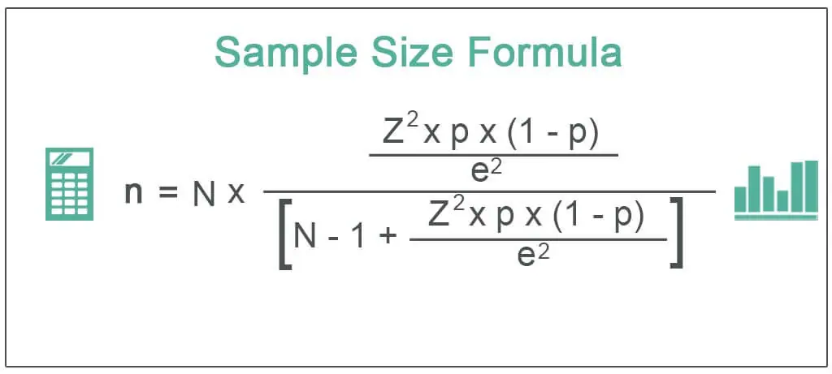
Sample Size Determination
Where;
N= Population Size
Z=Critical value of the normal distribution at the required confidence level
p = Sample proportion,
e = Margin of error

Slide 12
Methods of Data Collection
The following methods will be used;
Focus Group Discussions
Key Informant interviews
Any other methods that may be deemed appropriate
Data Collection Tools
Focus Group Discussion Guide
Interview Guide
Any other tool that may be deemed appropriate

Slide 13
Data Analysis techniques
This proposal will use the following techniques for data analysis;
Grounded theory,
Interpretative phenomenological analysis,
Text interpretation (e.g. thematic coding)

Slide 14
Ethical consideration
Ethical considerations in research are a set of principles that guide research designs and practices.
There will be voluntary participation, informed consent, anonymity, confidentiality, no harm, among others.

Slide 15
References
Bank, W. (2006). Bank, W. (2006). Experiences with Oil Funds: Institutional and Financial Aspects,. Washington: World Bank.
Darkwah, A. K. ( 2012). THE IMPACT OF OIL AND GAS DISCOVERY AND EXPLORATION ON COMMUNITIES WITH EMPHASIS ON WOMEN. . Department of Sociology University of Ghana Legon.
Ngabiirwe, W. (2014). An in-depth Research on Oil and Gas Extraction Industry in East Africa: An African Feminist Perspective. . Akima Mama Wa Afrika.
Ross, M. L. (2008). Oil, Islam and Women. Cambridge University press.

Slide 16
Thank You

