Slide 1
HOW DO ENERGY-TRANSITION DRIVERS INFLUENCE UGANDA’S DEVELOPMENT PATHWAY?
BY
MAUREEN WANDEKA NAMONO

Slide 2
1.0 Background of the study
Energy is one of the key driving forces of any economy, with the economic development of states depending on access to energy especially electricity (Borowski, 2021).
Internationally the energy system is going through a transition to renewable energy (Nwaneto et al., 2019)
The Paris agreement, Article 2.1 (b) encourages a transition from a fossil-fuel-based economy to a development path with low greenhouse gas emissions (Delbeke et al., 2019)

Slide 3
Count.’
Renewable energy is on a gradual rise across Africa with an annual growth rate of 21% between 2010 and 2020 (Pwc, 2021).
As the 2030 Agenda took effect globally, the Uganda government has integrated the Sustainable Development Goals (SDGs) into the national plan (European Commission, 2021).
Access to energy increased the productivity of households and communities through promoting commerce, service delivery, and education (WWF Paper, 2021)

Slide 4
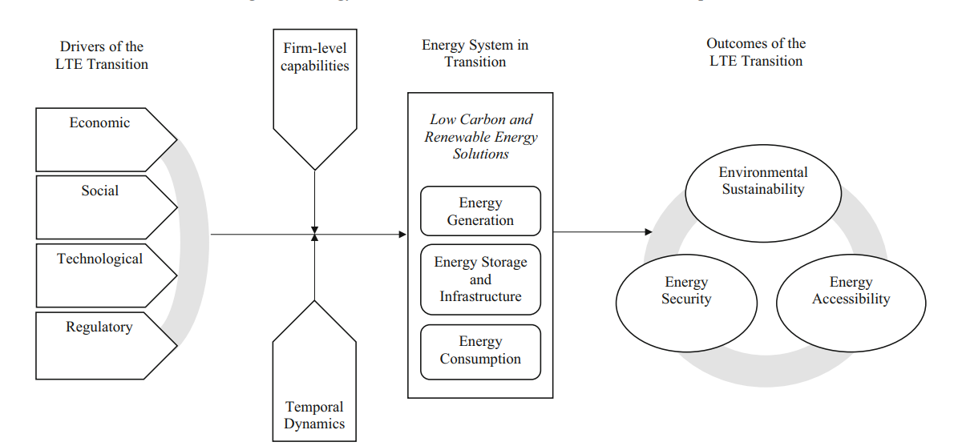
Count.’
Fig 1 Long-term energy transition framework for multinational enterprises.
Source: Journal of International Business Studies (Bass & Grøgaard, 2021)
The study points out the energy-transition drivers both at global and national level and how these drivers influence Uganda’s development pathway.

Slide 5
2.0 Problem statement
Limiting global warming to 1.5 °C and enabling socio-economic development that is inclusive and equitable are the world’s pressing challenges (Mercedes & Cantarero, 2020)
To achieve the targets of the Paris Agreement on climate change, Africa must forego burning 90% of known reserves of coal, 34% of gas and 26% of oil (UNU-INRA, 2019)
In Uganda, hydropower largely facilitates renewable energy access for social and productive use, these are still powered primarily by biomass and fossil fuels (DRAFT OF NATIONAL ENERGY POLICY, 2021)

Slide 6
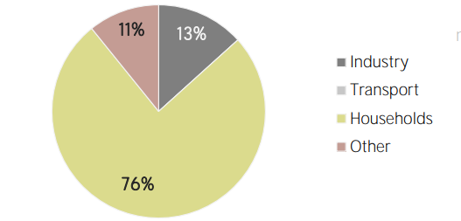
Count.’
Fig 2: Renewable energy consumption
Source: IRENA (2022)

Slide 7
Purpose of the study
The main purpose of this study is to assess how energy-transition drivers influence Uganda’s development pathway.
Research objectives
To analyze the energy-transition drivers at the global level.
To assess the energy-transition drivers at the national level.
To understand how these drivers influence Uganda’s development pathway.

Slide 8
3.0 Methodology
Research design
The research will employ an interdisciplinary approach of integrating qualitative foresight analysis and quantitative energy modeling to reflect the interlinked dynamics associated with energy and development.
Qualitative foresight analysis
Following (Ansari et al., 2018) & (Ansari & Holz, 2019), qualitative forecast analysis will develop possible future scenarios/narratives about probable changes in energy and development dimensions until the year 2050.

Slide 9
Count.’
Quantitative energy modelling
Quantitative energy modelling will be used to quantify the energy transition drivers identified through desk research.
Integrating qualitative and Quantitative results
The quantitative results and the qualitative scenarios will obtain rounded narratives that describe energy and development pathways while considering broader drivers of energy-transition (Ansari & Holz, 2019).

Slide 10
References
Ansari, D. (n.d.). Case Study report on scenarios of the global fossil fuel markets.pdf.
Ansari, D., & Holz, F. (2019). Anticipating global energy, climate and policy in 2055: Constructing qualitative and quantitative narratives. Energy Research and Social Science, 58(January), 101250. https://doi.org/10.1016/j.erss.2019.101250
Bass, A. E., & Grøgaard, B. (2021). The long-term energy transition : Drivers , outcomes , and the role of the multinational enterprise. Journal of International Business Studies, 52(5), 807–823. https://doi.org/10.1057/s41267-021-00432-3
Delbeke, J., Runge-Metzger, A., Slingenberg, Y., & Werksman, J. (2019). The paris agreement. Towards a Climate-Neutral Europe: Curbing the Trend, 24–45. https://doi.org/10.4324/9789276082569-2
European Commission. (2021). Uganda goes green and circular Milestones in the transition (Vol. 9, Issue November). https://doi.org/10.3389/fenrg.2021.724021

Slide 11
Count.’
Ansari, D. (n.d.). Case Study report on scenarios of the global fossil fuel markets.pdf.
Ansari, D., & Holz, F. (2019). Anticipating global energy, climate and policy in 2055: Constructing qualitative and quantitative narratives. Energy Research and Social Science, 58(January), 101250. https://doi.org/10.1016/j.erss.2019.101250
Bass, A. E., & Grøgaard, B. (2021). The long-term energy transition : Drivers , outcomes , and the role of the multinational enterprise. Journal of International Business Studies, 52(5), 807–823. https://doi.org/10.1057/s41267-021-00432-3
Delbeke, J., Runge-Metzger, A., Slingenberg, Y., & Werksman, J. (2019). The paris agreement. Towards a Climate-Neutral Europe: Curbing the Trend, 24–45. https://doi.org/10.4324/9789276082569-2
Mercedes, M., & Cantarero, V. (2020). Energy Research & Social Science Of renewable energy , energy democracy , and sustainable development : A roadmap to accelerate the energy transition in developing countries. Energy Research & Social Science, 70(July), 101716. https://doi.org/10.1016/j.erss.2020.101716

Slide 12
Count.’
Nwaneto, U. C., Akuru, U. B., Udenze, P. I., Awah, C. C., & Okoro, O. I. (2019). Economic implications of renewable energy transition in Nigeria. Proceedings of the Conference on the Industrial and Commercial Use of Energy, ICUE, 2018-Augus.
Paper, W. W. F. D. (2021). WWF DISCUSSION PAPER JUST ENERGY. November.
Profile, E. (2019). COUNTRY INDICATORS AND SDGS. 2–5.
Pwc. (2021). AFRICA ENERGY REVIEW (Vol. 9, Issue November). https://doi.org/10.3389/fenrg.2021.724021
UNU-INRA. (2019). Africa’s development in the age of stranded assets. 44. https://i.unu.edu/media/inra.unu.edu/publication/5247/

