Slide 1
Determinants of willingness to adopt clean cooking technologies. The case of slums in Kampala.
BY
LUKYAMUZI VICENT

Slide 2
Background of the study
The United Nations Sustainable Development Goal (SDG) 7 focuses on a concerted global effort to ensure access to affordable, reliable, sustainable and modern energy for all, Target 7.2: is to increase the share of renewable energy in the global energy mix.“
Renewables deployment has been a component of national planning agenda for many developed and developing countries over the past few years (Aguirre & Ibikunle, 2014
Vision 2040, Ugandans aspire to have access to clean, affordable and reliable energy sources, to facilitate industrialization.
The government through the National Development Plan (NDP II), NDP III and Energy policy is committed to increase the use of clean cooking technologies (NPA, 2020; MEMD, 2019).

Slide 3
Uganda’s energy composition

Slide 4
cont.
Composition of the Uganda's current cooking energy sources
94% depend on Biomass, (73% is firewood , and 21% charcoal)
1.4% depend on electricity, 0.6% kerosene and 3.9%others. Joshua et al, (2022)
27% of the Uganda's total population lives in urban areas ,of which 93% is living in slums of which 86% of this population uses biomass (Rugadya et al., 2008)
A slum is a run-down area of a city characterized by substandard housing, squalor and lacking in tenure security. Encyclopedia, (2008)

Slide 5
cont.
This over-reliance on traditional biomass is an indicator of a country trapped in a tragedy of environmental degradation and its concomitant impacts related to health, gender and household expenditure (GIZ, 2014)
Approximately 11% of lung cancer deaths in adults are attributable to exposure to carcinogens from household air pollution and ,
Globally each year 3.2 million people die prematurely from illnesses attributable to the household air pollution due to cooking (WHO,2014)

Slide 6
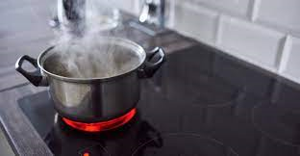
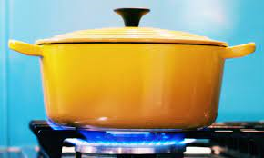
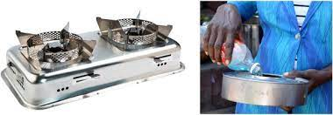
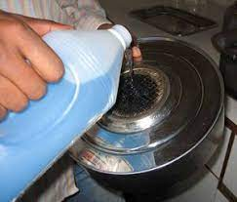
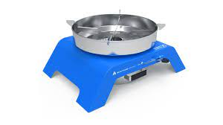
cont.
Where Uganda hopes to be :
Biofuels
LPG
Piped natural gas
Electricity
These fuels are truly clean at point of use and the transition needs to focus on them, Van Leeuwen et al (2017)

Slide 7
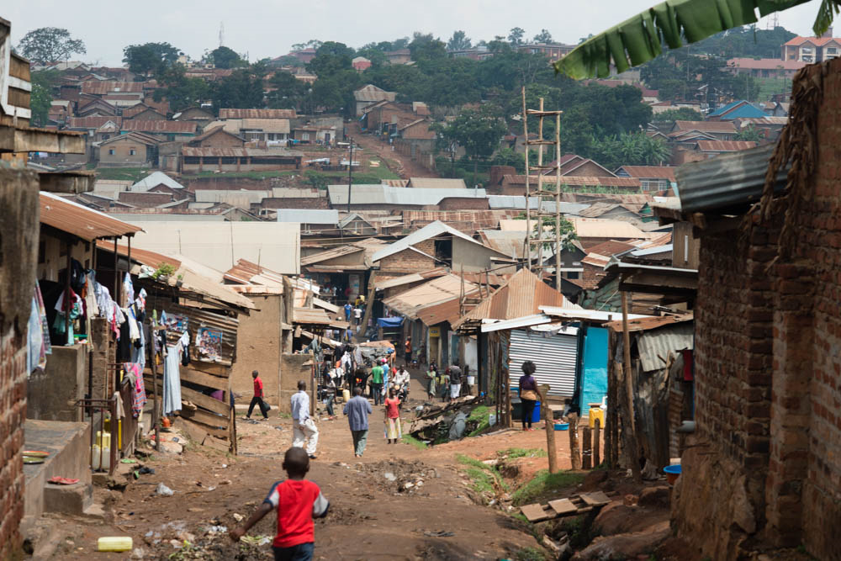
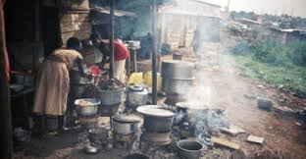
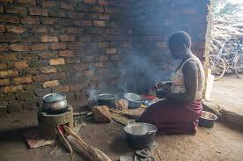
Cont.
Many studies have been done especially for slums but few are paying attention to gender and willingness in addressing this problem ,
There is a practical problem which this research will handle especially in slums , looking at the willingness to pay and how much to pay .

Slide 8
Statement of the problem
The Ugandan government has coordinated an integrated National Clean Cooking strategy in a bid to achieve clean cooking targets stipulated in the National Development Plan Target (NDP III)
The Government through the Electricity Regulatory Authority (ERA) introduced a cooking tariff, subsidized liquefied gas cylinders and burners ,ethanol stoves among others have been put in place to increase the adoption to clean cooking fuels . Price, R.A. (2017)
However 94% of the population still depends on Biomass of which 73% is firewood and 21% charcoal. Joshua et al, (2022) . In the same report few slum dwellers are have adopted to Bio fuel, LPG ,electricity among others

Slide 9
Cont.
The dependence on Biomass has caused adverse effects including Diseases(WHO,2014), land degradation (deforestation), Accidents , among others ,(NFA 2009)
There for this study aims at assessing the willingness of slum dwellers to adopt clean cooking technologies .

Slide 10
Purpose of the study
The purpose of this study is to assess the willingness of slum dwellers to adopt clean cooking technologies
Objectives of the study
Examine the factors affecting the willingness of slum dwellers to adopt to clean cooking technologies.
To estimate how much slum dwellers are willing to pay for clean cooking technologies.
To assess the differences between women and men’s willingness to pay for the clean cooking technology

Slide 11
Methodology
The study will employ both contingency valuation method (CVM) and choice experimental method ,
The contingency valuation method will focus on primary data, through questionnaires.
The choice experiment method will focus on uncovering and elicit how slum dweller’s preferences on clean cooking technologies. (Venkatachalam, 2004)
To achieve an all round description that will analyze the situation of slum dwellers and answer the objectives , both methods will be used.

Slide 12
References
Aguirre, M., & Ibikunle, G. (2014). Determinants of renewable energy growth: A global sample analysis. Energy Policy, 69, 374–384. https://doi.org/10.1016/j.enpol.2014.02.036
Overview, C. (N.D.A). Renewable Energy. 1–8.
Ogwok, J., Nalumagga, A., Abbo, S., Testa, M. (2022).Ugandas cooking energy sector : a review. Modern Energy Cooking Services ,may ,16-20
Rugadya, M., Kamusiime, H., Nsamba-Gayiiya, E., & Koojo, C. (2008). A Situation Analysis of Slums in Uganda and National Slum Upgrading Strategy and Action Plan. Department of Human and Settlements: Ministry of Lands, Housing and Urban Development, December, 1–55.
Venkatachalam, L. (2004). The contingent valuation method: A review. Environmental Impact Assessment Review, 24(1), 89–124. https://doi.org/10.1016/S0195- 9255(03)00138-0

Slide 13
Cont.
Exploration, P. (2005). Ministry of Energy and Mineral Development. East, March, 1–2.
UBOS. (2021). Uganda National Household Survey 2019/2020. 14.
World Health Organization (WHO). Public health, environmental and social determinants of health (PHE), Geneva. 2014.
Price, R.A. (2017) “Clean” Cooking Energy in Uganda – technologies, impacts, and key barriers and enablers to market acceleration. K4D Helpdesk Report. Brighton, UK: Institute of Development Studies.

Slide 14
The end
Thanks for listening

