Slide 1
ENVIRONMENTAL AND SOCIO-ECONOMIC EFFECTS OF CRUDE OIL EXTRACTION IN BENTIU -SOUTH SUDAN BY DANIEL MADET CUOR YOL
MAKERERE UNIVERSITY BUSINESS SCHOOL FACULTY OF GRADUATE STUDIES AND RESEARCH 11TH OCT 2022

Slide 2
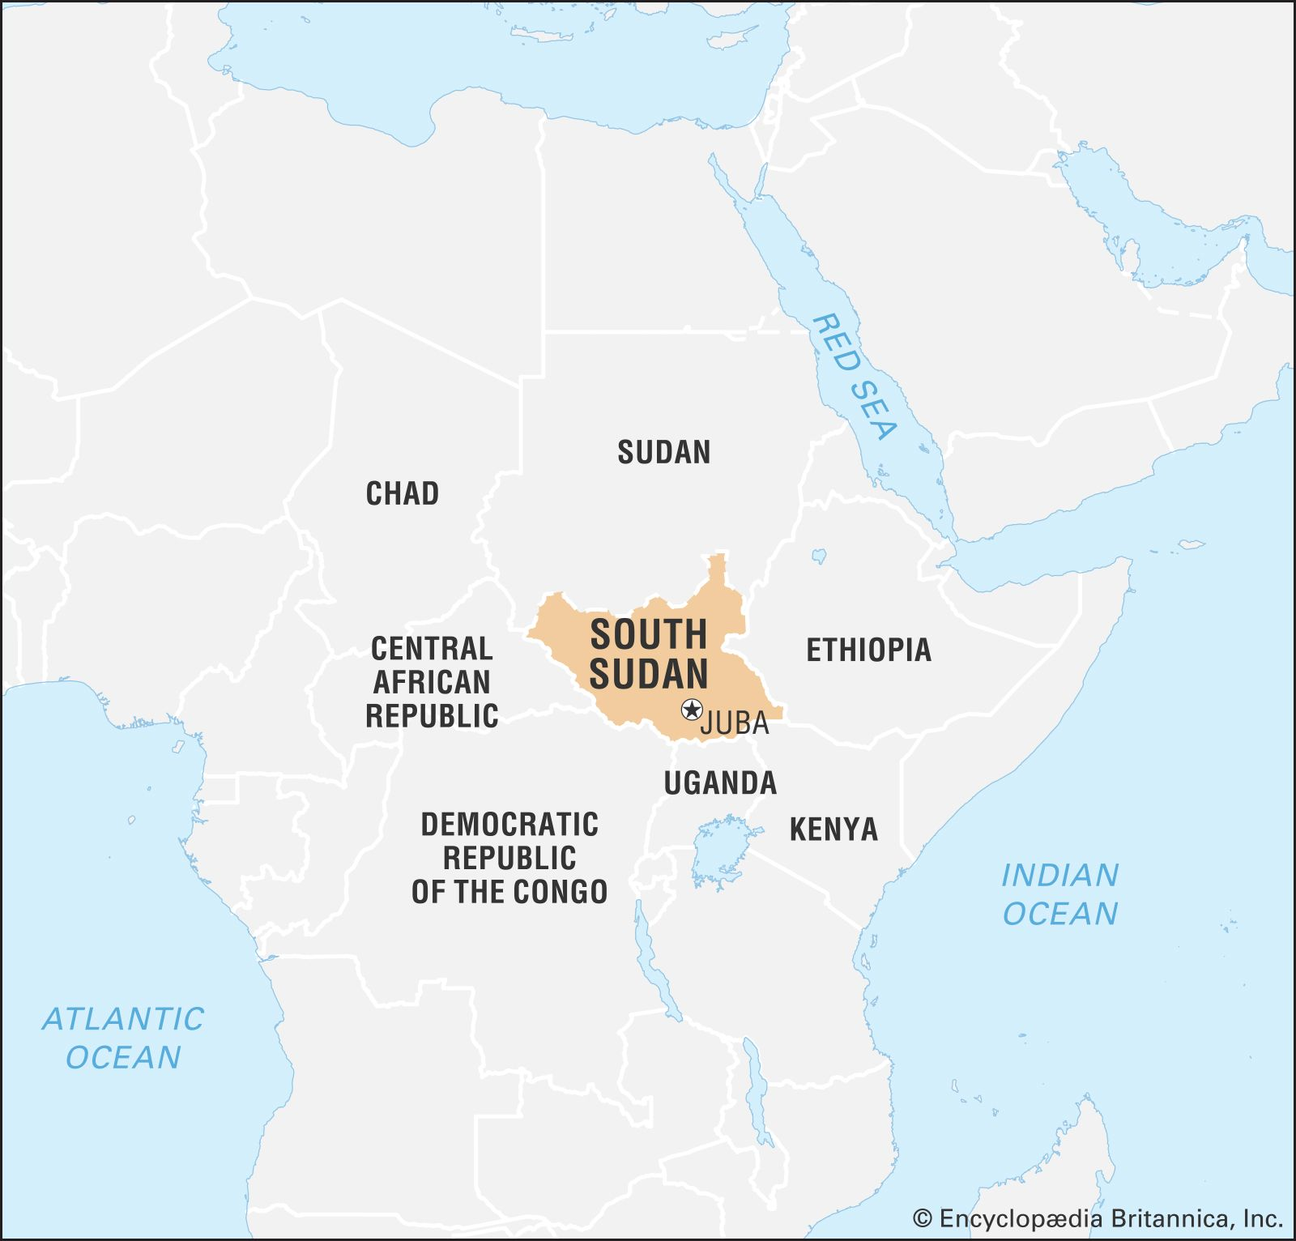
Background
South Sudan is a landlocked country in Northeastern Africa.
Gained her independence on July 9th 2011 from Sudan after twenty-one years of civil war.
Population: (2022 est.) 14,235,000
GDP: $1Billion (2019 world Bank)
Area 644,330km2
Regions: Three (3)
States: (10) ) & three administrative areas.
Official language: English

Slide 3
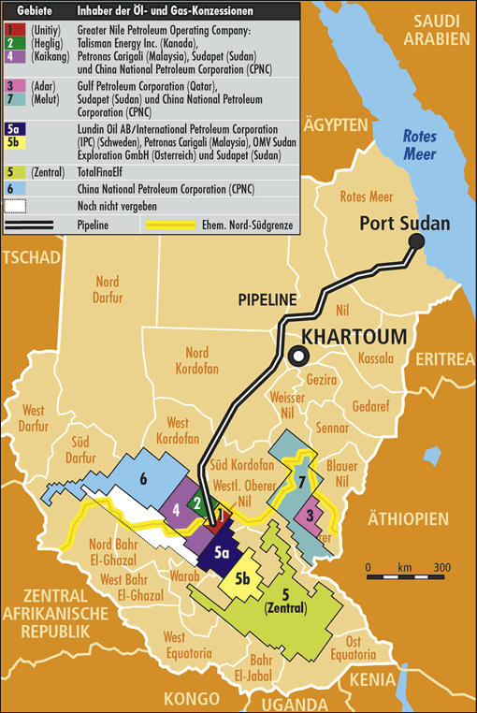
Cont.

Slide 4
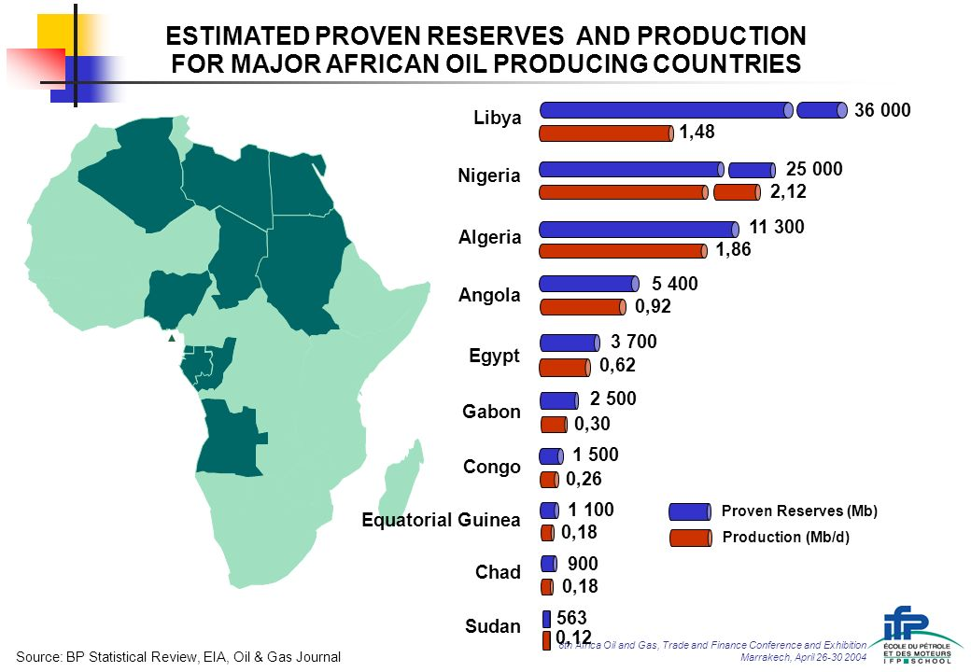
cont. Oil in African countries and South Sudan in particular.
Crude oil production is one of the leading sources of non-renewable energy worldwide. (Bp Statistical Review, EIA, Oil & Gas Journal March 30 2004).
The map shows selected 10 major oil producing countries in Africa.
Economies of most African countries are dependent on crude oil producttion.

Slide 5
Cont. South Sudan
Only about 30% of the explored oil is extracted putting South Sudan at the lowest position in the map (Augé, 2021).
Oil value chain is controlled by foreign companies; Chinese and Malaysians
Shares of oil by companies
A consortium of China National Petroleum Corporation (41%),
Petronas (40%),
Nilepet (8%),
Sinopec (6 %) and
Tri-Ocean Energy (5%),.

Slide 6
Cont.
Nilepet as the only National oil company in the crude oil value chain
Regulates
Import
Store oil
Oil in South Sudan accounted for;
about 50% of GDP,
exports about 97 %
and government’s revenue 98 % in the period 2008-2011
The economy of South Sudan is entirely dependent on crude oil production.

Slide 7
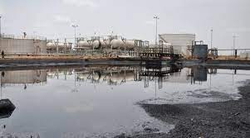
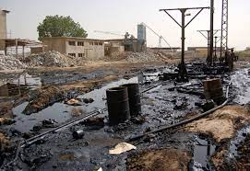
Problem statement
Despite economic benefits, crude oil production in South Sudan has major pitfalls;
hundreds of open waste pits
Oil and hazardous chemical spills
The above have lead to;
Birth defects
miscarriages
Environmental degradation
Skin rushes
And generally deteriorating health issues
Exposure to toxic chemicals such as lead, arsenic, manganese and benzene can cause a variety of health problems including cancer, respiratory problems, impotence and stillbirths, (World Health Organization).
Oil spill in Bentiu (May 2, 2016) Wim Zwijnenburg

Slide 8
Cont.
Mother Abui Mou with his son Ping Mayak who was born with one stunted leg, six fingers on each hand, deformed foot and swollen kidney in Upper Nile Palouch oil field.(ASSOCIATED PRESS FEB. 13, 2020).
These effects have not only been on human beings but also cows and goats have had such birth complications in oil fields of South Sudan.
Ping Mayak Geer with his mother Abui Mou Kueth while in Nairobi for treatment (AP Photo FEB. 13, 2020 )

Slide 9
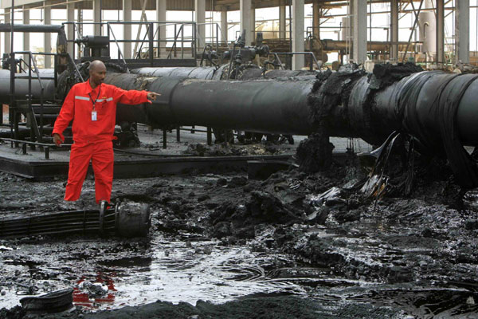
Cont.
Egbert Wesselink (former head of European coalition) said that South Sudan is running one of the dirtiest and poorest managed oil operations on the planet.
Report accuses the Chinese-led Dar Petroleum Operating Co. and the Greater Pioneer Operating Co. of;
Neglecting environmental and socio-economic concerns
Silencing those trying to write and publish reports on the problem
Sudanese engineer points at a damaged oil pipline in Heglig Oil field. (April 23 2012)

Slide 10
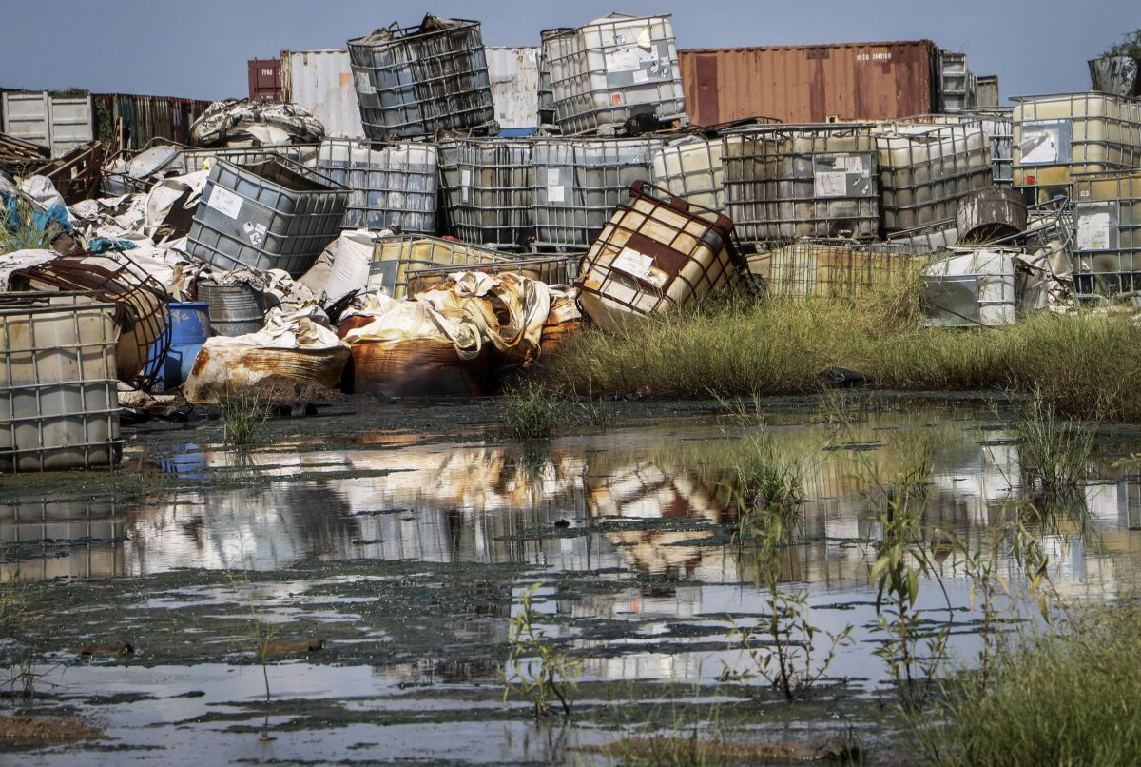
Cont.
Waste management by oil companies is very poor as seen in the photo
Oil companies fill hazardous wastes into containers which still make spillages on the environment.
Local communities lack clean drinking water
Clean water provided by oil companies is always not enough
The last option is to fetch water from open sources which are contaminated.
Containers used for hazardous chemicals are piled up at a junkyard near Paloch, South Sudan, in 2018.
(Associated Press)

Slide 11
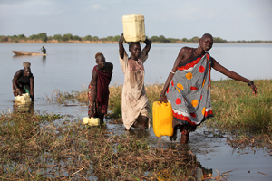
Cont.
Residents collecting water, between Melut and Paloch town, in South Sudan. (AP Photo/Sam Mednick February 13, 2020,)

Slide 12
Cont,
Despite the visible crude oil problems, the extend of the problem has not been critically analyzed and therefore this study will best link the environmental and socio-economic consequences of crude oil extraction in Bentiu South Sudan.

Slide 13
Objectives of the study
Main objective
To investigate the environmental and socio-economic effects of crude oil extraction in Bentiu South Sudan.
Specific objectives
To assess the effects of exposed crude oil on productivity.
To assess the effects of crude oil exposure on people’s health.
To assess the perceived effects of crude oil exposure in the quality of land, water and biodiversity.

Slide 14
Methodology
The study will use mix methods paradigms combining both the qualitative and quantitative approaches.
Qualitative method.
Focus groups discussions.
Interviews.
Self administered survey questionaires.
Quantitative method.
Secondary data such as statistics from;
Published reports or journal articles
Quantitative statistics obtained by survey questionnaire.

Slide 15
Justification
The study will provide evidence as to whether there are environmental and socio-economic effects of crude oil production in Bentiu oil field.
This will help in establishing the extent or severity of the problem and therefore offer a potential room for decision making and drafting of solutions.

Slide 16
THE END
THANK YOU ALL

